Slide 1

Auburn University
Ethical Hacking Club
Cybersecurity Bootcamp
Notes:
Charlie

Slide 2
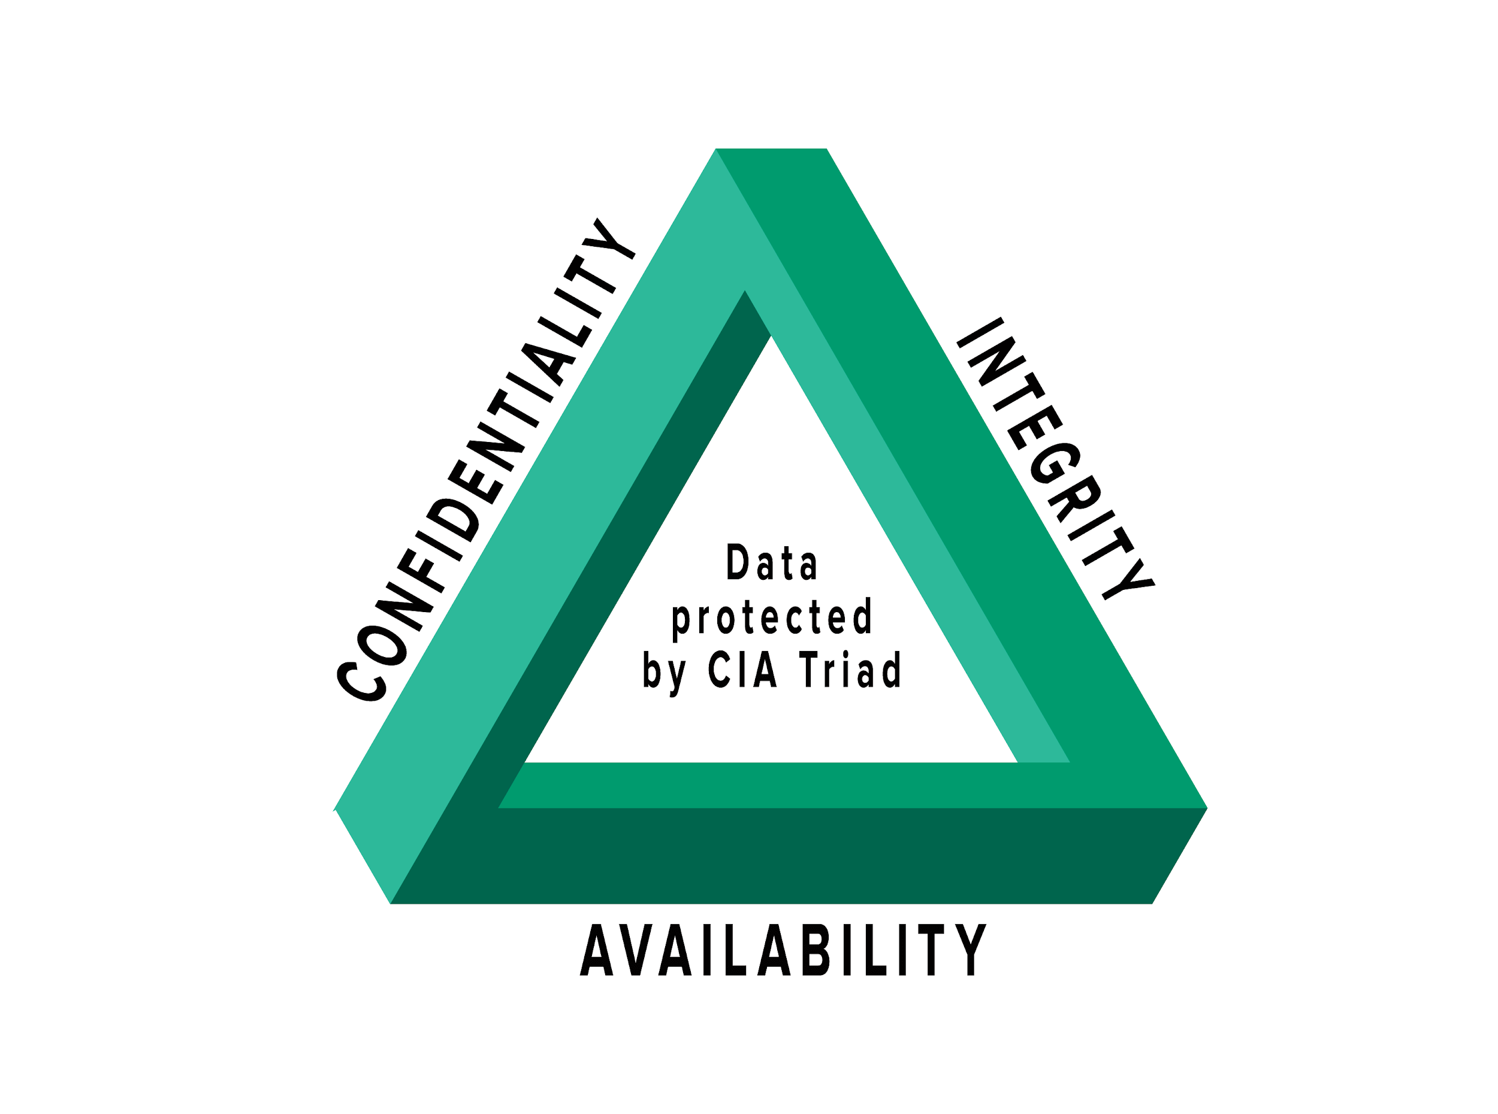
CIA Triad of Information Security
Confidentiality - Protect sensitive, private information from unauthorized access
File Encryption
Permissions
Control Lists
Integrity - Protect data from deletion and modification form an unauthorized party or individual
Backups
File Hashes
Digital Signatures
Availability - The availability of the data to be accessed by those who should be allowed access
Keeping systems up
Network outages
Denial of Service
Notes:
Ethan

Slide 3
Cryptography
Flip the bits and reverse it
Notes:
Ethan

Slide 4


Cryptography
What is cryptography? The development of secure information and communication techniques derived from mathematical concepts and algorithms.
Notes:
Ethan

Slide 5
Where is Cryptography used?
Cryptography is used in many different places:
Communication protocols HTTPS, SSH, …
Secure backup systems
File transfer protocols: SFTP, SSH SCP
Ransomware: WannaCry
Encrypted tunneling in Onion Routing
Cellular transmissions
And more...
Notes:
Ethan

Slide 6
How Does it work?
Encryption:
Taking data or messages and making it hard to read
Concealing the actual message so that an eavesdropper can not (easily) read it
How do we encrypt something?
Using Algorithms known as Ciphers
Using secret keys
Decryption:
Taking an encrypted message that is unreadable and transforming it back into the original message
Goals:
If an individual is not given the secret key, they can’t decrypt the message
Notes:
Ethan

Slide 7
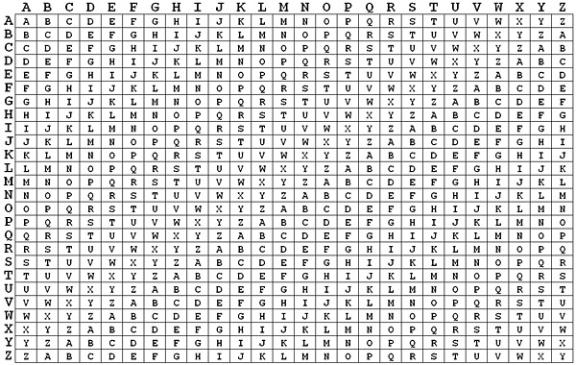
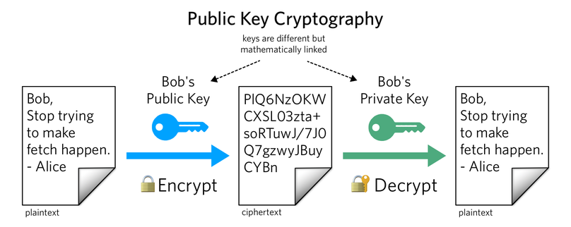
Symmetric and Asymmetric Ciphers
Symmetric - Use the same key for encryption and decryption (ex: Vigenere Cipher)
The key is shared between the sender and receiver
Asymmetric - Uses two keys where one is for encryption and the other is for decryption.
The encryption key, public key, is not secret
The decryption key, private key, is secret
Anyone can use the public key to encrypt a message but only the user with the private key can decrypt the message
Notes:
Ethan

Slide 8
Encryption Methods
Substitution Cipher is a method of encryption whereby a unit of the plaintext is replaced with a ciphertext value according some predefined system.
Transposition Cipher is a method of encryption where units of the plaintext are rearranged or transposed using some form complex order.
Notes:
Ethan

Slide 9
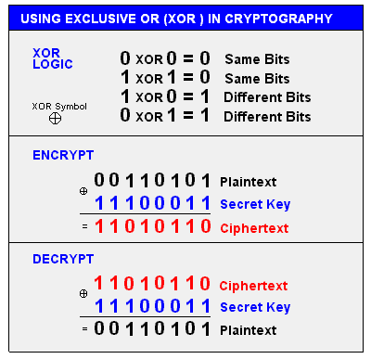
Some popular algorithms
Advanced Encryption Standard (AES)
One of the most widely used symmetrics encryption algorithm
Fast
No known attacks
Industry standard
Data Encryption Standard (DES)
Used widely up until the late 90s when it was proven to be broken
The reason DES did not work was due to a key length of 56 bits that was too short
Replaced by AES
Caesar Cipher
One of the oldest ciphers involves shifting the characters to other characters in the alphabet
1 Shift A -> B
4 Shift A -> E
XOR
Take a key and XOR it with the plaintext (Symmetric)
The XOR operator is also very common in much more complex ciphers
Notes:
Ethan

Slide 10
Cryptanalysis
Computational Resources Required
Time
Memory
Data
Attack Models
Ciphertext-only
Plaintext-only
Chosen Plaintext
Adaptive Chosen Plaintext
Related Key Attack
Frequency Analysis - Helps in determining the different distribution of letters, useful in substitution ciphers
Bruteforce - Generate a random key and plaintext then run it through the encryption until you get a match
Side Channel Attacks - Attacks on the implementation of the system rather than on the algorithm
Differential Analysis - Examination of how different inputs affect the output
Notes:
Ethan

Slide 11
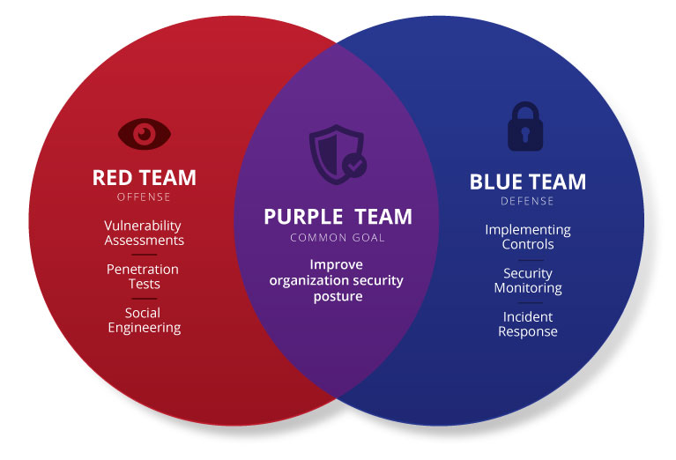
Notes:
Ethan

Slide 12

Defensive Security
The Defenders
Notes:
Ethan

Slide 13
What is Blue Team?
A group of people who perform analysis of information systems to ensure security.
Goals
Identify Targets
Restrict Access
Harden Systems
Analyze Information
Incident Response
Notes:
Ethan

Slide 14

Identify Targets
What are the most important parts of your system?
What is important to back up?
What parts need extra security?
What would an attacker want?
What is less important?
Notes:
Ethan

Slide 15
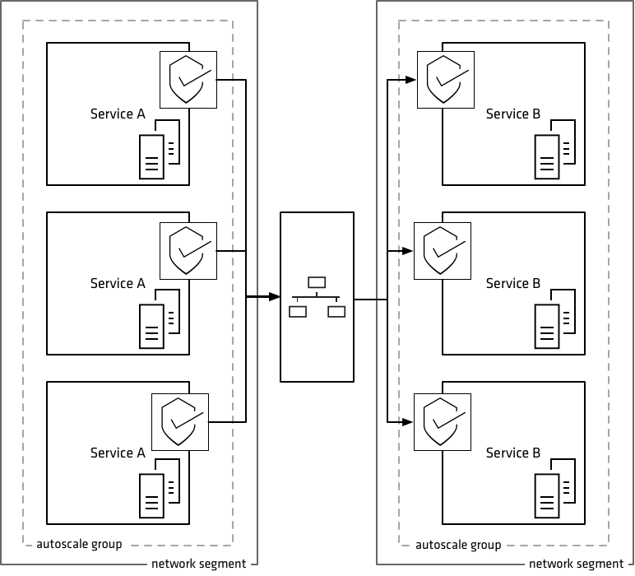
Restrict Access
Setting up a firewall, how strict do you want to be?
How do you handle physical access to the building(s) and room(s)?
How do you handle VPN?
Removable media?
Restricting permissions of regular users?
Network segregation and segmentation?
Notes:
Ethan

Slide 16
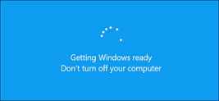
Harden Systems
Make sure all machines are patched
Test applications for vulnerabilities
COTS (Commercial Off The Shelf)
Internally created applications
Awareness Training
Configuration Management
Notes:
Ethan

Slide 17
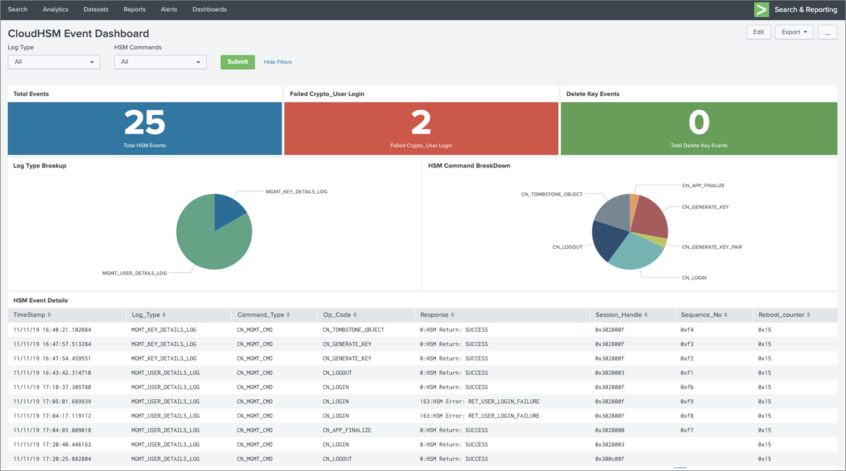
Analyze Information
Install software to collect information
EDR (endpoint detection and response)
IDS (intrusion detection system)
SIEM (security information and event manager)
Analyze and Correlate
Network Activity
Windows Events
EDR/IDS Alerts
Access
System Operations
Machine Learning
Assist with analysis
Visualizations
Notes:
Ethan

Slide 18
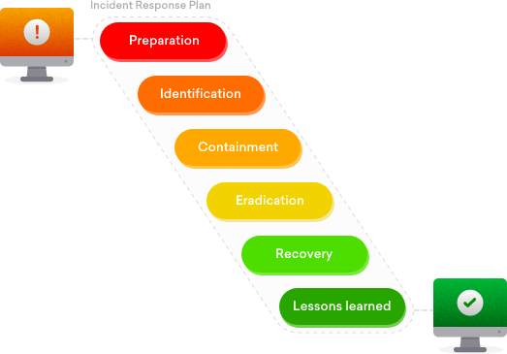
Incident Response
Contain the breach
Figure out the extent of the breach
Eradicate any persistence
Recover data
Traceback the origin of the incident
Fix vulnerability
Subcategories include:
Reverse Engineering
Digital Forensics
Network Analysis
Notes:
Ethan

Slide 19
Digital Forensics
Data Recovery
Notes:
Jon

Slide 20
What is Digital Forensics?
The investigation, collection, analysis, and recovery of digital artifacts
Goals
Identify
Preserve
Collect
Examine
Analyze
Present
Notes:
Jon

Slide 21
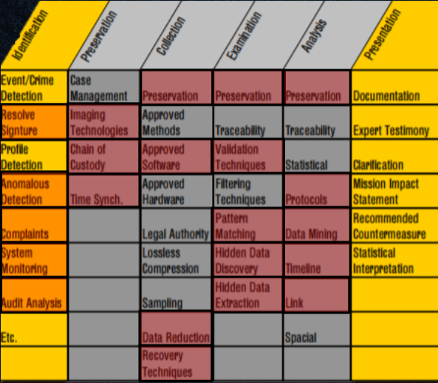
The Digital Forensics Process
Notes:
Jon

Slide 22


Examination and Analysis
What are we looking at
Partitions?
File systems?
Amount of data?
Figure out where everything is
Partitions start and end
FAT (File Allocation Table)
Data segment
Files within data segment
Looking for any hidden data
Steganography
File Slack
Unallocated Space
Disk
Partition
File System
Data Unit
Metadata
File Name
Notes:
Jon

Slide 23
Network Analysis
Data, data, and more data
Notes:
Zach

Slide 24
What is Network Analysis?
Monitoring and analyzing network traffic to prevent and identify malicious activity
Goals
Identify anomalous behavior
Network management and configuration
Incident response
Identify weak spots in the network
Notes:
Zach

Slide 25
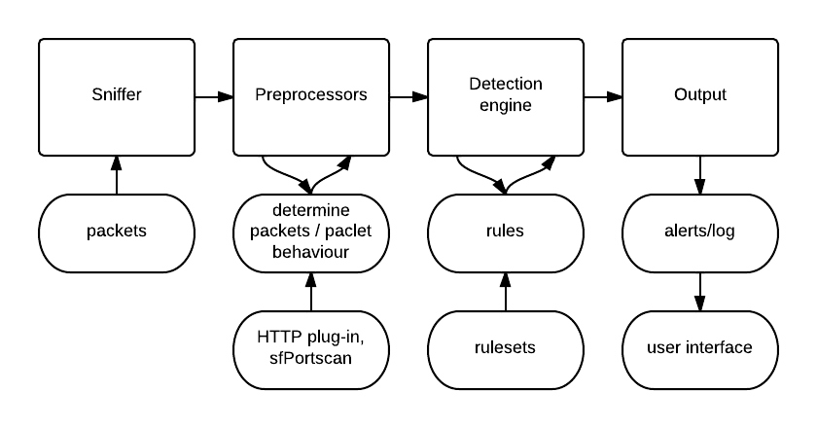
Network Analysis
How is our network configured?
What is abnormal activity for our network?
What parts of our network need to be monitored more closely?
What is the most vulnerable part of the network?
Try to fix vulnerable parts?
A incident has happened:
What does network traffic show?
Can we identify what happened?
Correlate with other data?
Notes:
Zach

Slide 26
Resources
Malware Traffic Analysis:
https://www.malware-traffic-analysis.net/
Notes:
Zach

Slide 27
Threat Intelligence
Think smarter, not harder
Notes:
Zach

Slide 28
Threat Intelligence
What is threat intelligence?
Knowledge that allows you to prevent or mitigate cyber attacks
Provides context that helps you make informed decisions about security
Answers questions:
Who is attacking you?
What are their motivations and capabilities?
What indicators of compromise to look for?
Indicator of compromise (IOC): some piece of evidence such as a url, IP address, file hash, etc. that indicates a compromise
https://www.recordedfuture.com/threat-intelligence/
Notes:
Zach

Slide 29
Types of Threat Intelligence
Strategic Intelligence
Provides a broad overview of an organization’s threat landscape
Intended to inform high-level decisions made by executives and other decision makers
Meant for a non-technical audience
Tactical Intelligence
Outlines the tactics, techniques, and procedures (TTPs) of threat actors
Helps defenders understand how their organization might be attacked and the best ways to defend against or mitigate those attacks
Meant for technical audience such as system architects, administrators, and security staff
Operational Intelligence
Knowledge about cyber attacks, events, or campaigns
Information like what attack vector is being used, what vulnerabilities are being exploited, or what command and control domains are being employed
Meant for technical audience
https://www.recordedfuture.com/threat-intelligence/
Notes:
Zach

Slide 30
Threat Intelligence Use Cases
Incident Response
Identify relevant information faster
Add context to IOCs
Security Operations Center (SOC)
Quickly identify relevant alerts
Provides context to better assess the severity of alerts
Vulnerability Management
Prioritize patching vulnerabilities based on identified risk
Risk Analysis
Develop more accurate risk models
Identify threat actors targeting your industry
Identify vulnerabilities in your environment
https://www.recordedfuture.com/threat-intelligence/
Notes:
Zach

Slide 31

Reverse Engineering
The Dark Heart of Hacking and other witchcrafteries
Notes:
Bon Jordan

Slide 32
What is it?
Software reverse engineering is the process of taking software apart and analyzing it
Binary reverse engineering is performed if the original source code of the software is not available
Primarily what we will be discussing
Notes:
Bon Jordan

Slide 33






Soft Skills
Love to take things apart to figure out how it works
Love puzzle solving
Enjoy developing experiments and tools
Can think outside the box
Love constantly learning new things
High tolerance to frustration
Notes:
Jordan

Slide 34




Technical Skills
Familiarity with an assembly language
Strong knowledge of compiled programming languages
Understanding of bitwise operations and their use of encodings
Ability to google
Notes:
Jordan

Slide 35



Where is it used?
MALWARE ANALYSIS
BINARY EXPLOITATION
LEGACY CODE SUPPORT
INCIDENT RESPONSE
Notes:
Malware analysis: dissecting malware samples to figure out how and why they work and what their overall functionality is
Binary exploitation: discovering vulnerabilities within binary applications that can lead to security holes in the computer
Incident Response: using re techniques to find incidents of compromise within malware samples
Jordan

Slide 36
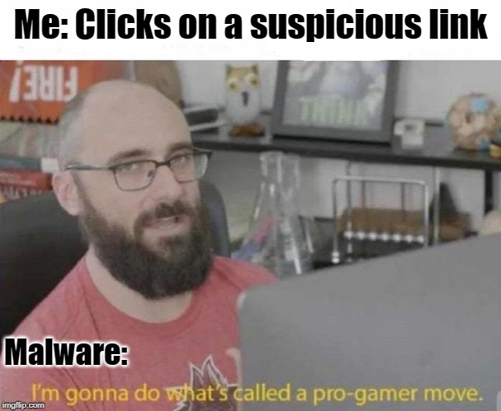
Malware Analysis
What is malware?
Any software that does something that causes detriment to the user, computer, or network
What is malware analysis?
The art of dissecting malware to understand how it works, how to identify it, and how to defeat or eliminate it
Notes:
Zach

Slide 37


Types of Malware
Backdoor - malicious code to allow the attacker access with little or no authentication
Botnet - infected computers that receive instructions from a single command-and-control server
Spyware - collects information to send to attacker
Rootkit - designed to conceal the existence of other code, usually paired with backdoor
Scareware - designed to frighten the infected user
Ransomware - designed to block access to a computer system/files until a sum of money is paid
Adware - displays advertisements
Worm - replicates itself without a host program
Trojan - disguised as legitimate program
Virus - replicates itself using a host program
Notes:
Zach

Slide 38

Types of Malware Analysis
Static analysis
Analyzing the code or structure of a program to determine its function
Look at strings, Windows function calls, etc.
Disassemble to examine assembly code using tools like IDA or Ghidra
Dynamic analysis
Examination performed by executing malware
Use tools like INetSim or Wireshark to see the network behavior
Examine registry entries before and after executing
Look for newly created processes, files, etc.
Notes:
Zach

Slide 39

Resources
Practical Malware Analysis
Practice Reverse Engineering
Reversing: Secrets of Reverse Engineering
Reverse Engineering for Beginners
More!
Notes:
Zach and Jordan

Slide 40

Offensive Security
The Attackers
Notes:
Charlie

Slide 41
What is Offensive Security?
The assessment of a system or organization’s security posture through the perspective of an adversary
Goals
Research
Assess
Report
Notes:
Charlie

Slide 42

Why are we Attacking?
By looking at a system through the eyes of an attacker we are able to mimic the behavior and attack patterns that an adversary might execute in the wild
Fix vulnerabilities that are realistic
Help train blue teams by offering realistic network traffic, assisting them in hardening their systems.
Jobs in the offensive security world:
Pentesting
Red Teaming
Exploit Developer
Offensive Security Engineer
And more
Notes:
“In the wild” - meaning?
Charlie

Slide 43
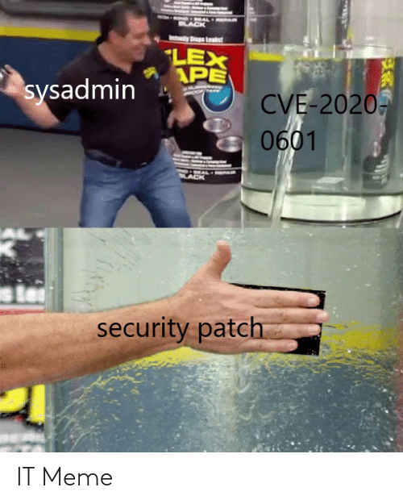
Vulnerabilities, Exploits, and Threats
Vulnerability:
Bugs, misconfigurations, and or design flaws
MITRE registers known vulnerabilities as CVEs (Common vulnerability or exposure)
Exploit:
Leveraging a vulnerability
Threat:
A scenario where an attacker leverages a vulnerability to attack a system
https://www.rapid7.com/fundamentals/vulnerabilities-exploits-threats/
Notes:
References and resources: https://www.rapid7.com/fundamentals/vulnerabilities-exploits-threats/
Charlie

Slide 44
How do we attack?
Research, Research, Research
Scanning their systems - open ports, services, etc.
Nmap, unicornscan, zmap, mass scan
Ex: Port 445 open to public, uh-oh!
Checking their IP-ranges
ICANN - lookup.icann.org, Dig, nslookup
Who bought the domain, mail servers, admin contact information, etc.
Checking what is valuable to them - products
What are they known for?
This will often be the target
Checking their forward facing assets
Websites, sharepoints, jump boxes
How are they contacted? Important people? IT?
What Next?
After you know about the system, you can map their forward facing systems.
Start planning how you can get initial access onto their system, or start working on a vulnerability found during scanning phase.
In penetration testing, more often than not finding the vulnerability and creating a PROOF OF CONCEPT (PoC) that exploits the vulnerability is enough - Red Teams often go further.
Notes:
Charlie

Slide 45
Red Teaming and Pentesting
Cyber Ninjas
Notes:
Charlie

Slide 46
Pentesting
Red Teaming
Find as many vulnerabilities and configuration issues as possible within the timeframe of an operation
Usually is not about finding NEW zero-day vulnerabilities, rather looking at known vulnerabilities.
Make a Proof-of-concept, exploiting the vulnerabilities they find
LOUD
More targeted approach than penetration testing
Not about finding the most vulnerabilities, rather to reach certain objectives or flags.
Emulates a malicious threat actor
Ideally, Red Teamers are QUIET
Operations can last as short as a penetration test, or as long as a few years.
Have to weigh risk vs. gain
Pick vulnerabilities that will help them get to their goals, but that are not too loud.
Notes:
Reference: https://blog.rapid7.com/2016/06/23/penetration-testing-vs-red-teaming-the-age-old-debate-of-pirates-vs-ninja-continues/
Vicki

Slide 47

Pentesting Resources
Hack the Box:
https://www.hackthebox.eu/
Vulnhub:
https://www.vulnhub.com/
Notes:
Charlie

Slide 48
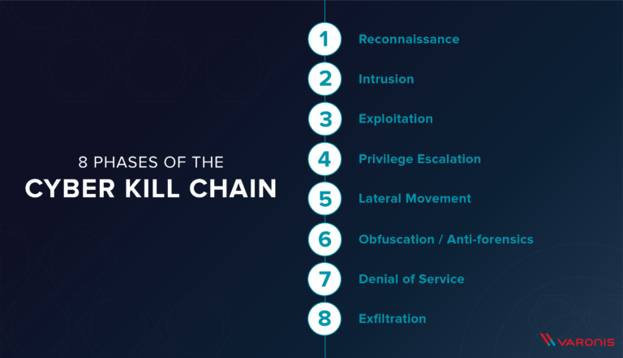
Cyber Kill Chain
Notes:
https://www.varonis.com/blog/cyber-kill-chain/
Charlie

Slide 49
Reconnaissance - OSINT
Observe and Report OSINT
Assess the system from outside-in.
Assess targets, tactics, and prepare for an attack
Notes:
Vicki

Slide 50

OSINT
Internet stal*cough* research
Notes:
Vicki

Slide 51
OSINT - Open Source Intelligence
Finding information on target using publicly available information.
Websites
Social media
Google Dorking
Reverse Image Search
Etc.
Notes:
Vicki

Slide 52

Websites
What do they host on their own website?
Do they list company emails?
Do they list client information?
Do they host files on their website?
What kind of files?
Do they remove PII from files?
Can you upload files to the website?
Do they have social media or expose employee names?
Notes:
Vicki

Slide 53
Social Media
Social Media is an OSINT gold mine
Generally used by Human Resources during hiring phases, or Personal Investigators during cases
Most people post all of their thoughts on social media
The internet always remembers. Cached websites to observer the changes that were made to web pages:
Wayback machine
Google cache
Retrieve deleted messages from twitter, reddit, Github
Look at posts that may reveal things that are blackmail worthy
Pinpoint interests and PII for password cracking, account recoveries and for further investigation
Notes:
Vicki

Slide 54
Google Dorking
Google Dorking
Advanced searches on Google
Uses specific operators to narrow down Google search queries
Reverse Image Search
Take an image and look for its source or instances of the same image or similar images
ALWAYS use more than one search engine
Yandex
Google
Bing
Etc.
Notes:
Vicki

Slide 55
OSINT Resources
Verif!cation Quiz Bot:
https://twitter.com/quiztime?lang=en
Trace Labs:
https://www.tracelabs.org/
Sourcing Games:
https://www.sourcing.games/
Notes:
Vicki

Slide 56
2) Intrusion
Using information from Reconnaissance phase, using any of the given techniques to find a way into your network and establish a foothold.
Approaches:
Port scanning and finding vulnerable services
Can be loud if taking the wrong approach
May have endpoint detection
Phishing
Can result in unwanted results from forwarding emails, Organizational email scanners, cyber security training.
Creating an account with access to the internal
What kind of resources are available to you from the outside?
Default creds on forward facing assets
Notes:
Charlie

Slide 57


Phishing
Phishing is messages sent to targets in an attempt to manipulate them into doing something.
Often you want to have the target do one of the following:
Give up personally identifiable information (PII)
Click a link that leads to a spoofed (faked) website that will have them input credentials
Download and execute some file that will grant remote access or infection of a remote system
You name it!
Notes:
Vicki

Slide 58
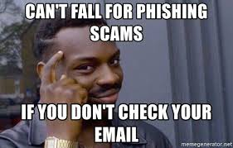
Types of Phishing
Phishing - emails sent to organizations or the general public to try and manipulate the targets. Think of this as casting a net over a large subset of the internet.
Spear Phishing - targeted messages against specific targets.
Whaling - targeted messages against high-value targets of great importance.
Smishing and Vishing - Smishing uses text messages as the platform of attack, and Vishing uses telephones
Notes:
Vicki

Slide 59
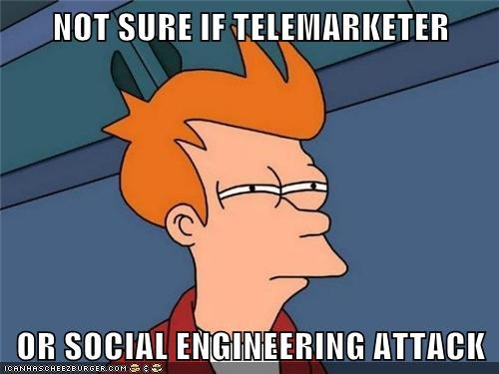
Social Engineering
Manipulating people into doing something they did not intend to do or unwittingly divulging information
Why is this important?
People are always the weakest link in the security chain
If you can call someone from the company and convince them to give you information, download a file, or run some script, you can easily get on to a network
Notes:
Vicki

Slide 60
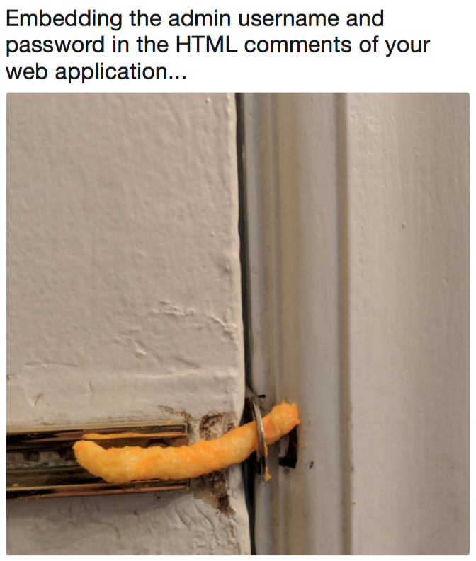
Web Application Hacking
Notes:
Charlie

Slide 61
Web Application Hacking
Injection
Inputting a value that is directly passed to the backend server. If the input is not handled correctly, cleaned, etc. then one can access and modify the database from the browser.
SQL, NoSQL, OS, LDAP
Broken Authentication
Poor session management and authentication functions lead to attackers being able to compromise credentials or sessions for other users.
Sensitive Data Exposure
Sensitive information like PII, financial documents, internal documents, etc. might be exposed to the internet by misconfiguration of a web application, or ignorance.
XML External Entities
‘XML processors evaluate entity references within XML documents.’ This can be used to access files, create remote code execution (RCEs), or a variety of other unintended actions.
Broken Access Control
Users are able to do things they shouldn’t be able to.
https://owasp.org/www-project-top-ten/
Notes:
https://owasp.org/www-project-top-ten/
Charlie

Slide 62
Technologies
Intercept Proxies:
Intercept traffic going from client to server.
Allows for manual modification of traffic before passing it to the server.
Example: Burp Suite, OWASP ZAP
HTTP/HTTPS
Hypertext transfer protocol [secure]
Website goodness
Notes:
Charlie

Slide 63
Resources
Hack This Site:
https://www.hackthissite.org/
OWASP Juice Shop
https://owasp.org/www-project-juice-shop/
Web Goat
https://owasp.org/www-project-webgoat/
OWASP
https://owasp.org/

Slide 64
3) Exploitation - Persistence
Once you have established a foothold on the network, now you want to ensure you stay on that network.
Avoid getting kicked off of the system after a reboot (running out of memory from a launched executable)
Burned user when they discover your created/used account

Slide 65
4) Privilege Escalation
After you are certain you can stay on the system after reboots, now you want to be able to get a more privileged user so you can do more with the system and move around the network a little easier.
Enumerate the system to look for stored passwords in plaintext
Token manipulation and impersonation
DLL search order hijacking
Binary abuse/misuse
Exploiting SUDO rights
https://www.cynet.com/network-attacks/privilege-escalation/

Slide 66
5) Lateral Movement
After you have your privileged user, now you want to laterally move around the network and get a better idea what resides on the internal.
Lateral movement is moving from one computer on the network to another.
Finding systems with juicy information or to establish footholds - network persistence

Slide 67
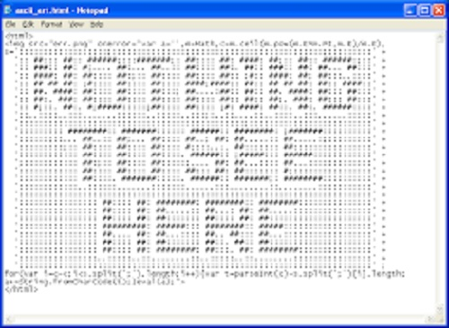
6) Obfuscation/Anti-forensics
Covering your tracks so you are not detected.
Deleting logs
Slowing down connections between computers or to your Command-and-conquer platform
Encrypting payloads
Use false trails
Use techniques or tools from other adversaries to throw them off your trail

Slide 68

7) Denial of Service
Update firewalls to block to legitimate IP addresses
Delete resources
Block services
Crash systems
Set off alarms
Once network persistence and control has been established, you can start denying legitimate users from resources on the network.

Slide 69

8) Exfiltration
Pull the data and get out of the system
What data are you pulling?
Where are you moving it?

Slide 70
Questions?
>

